Slide 2
On your mark, get set , go !!!

Slide 3
MISSION EMPOWERMENT A RAY OF HOPE
After tie up with UFHE, Sankalp entered into a collaboration with Empowered Kids Foundation, an NGO run by our esteemed Alumnus , Mr. Vivek Kumar and what followed was a ray of hope for the underprivileged children residing in the slum areas of Bantanagar and Rickshaw Basti, Adityapur
Sankalp started tuition classes for students with low or average learning skills and educational level from class3-9th near Durga Mandap, MIG Colony
Special classes for selected bright students for Navodaya also commenced at the same centre.

Slide 5
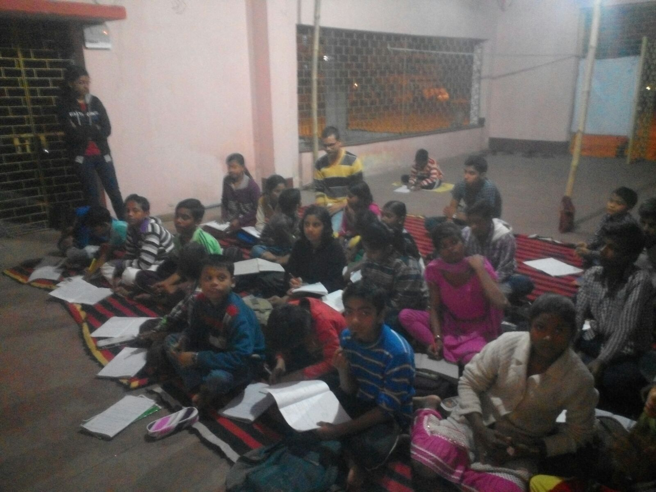
CARVING A NEW FUTURE

Slide 6
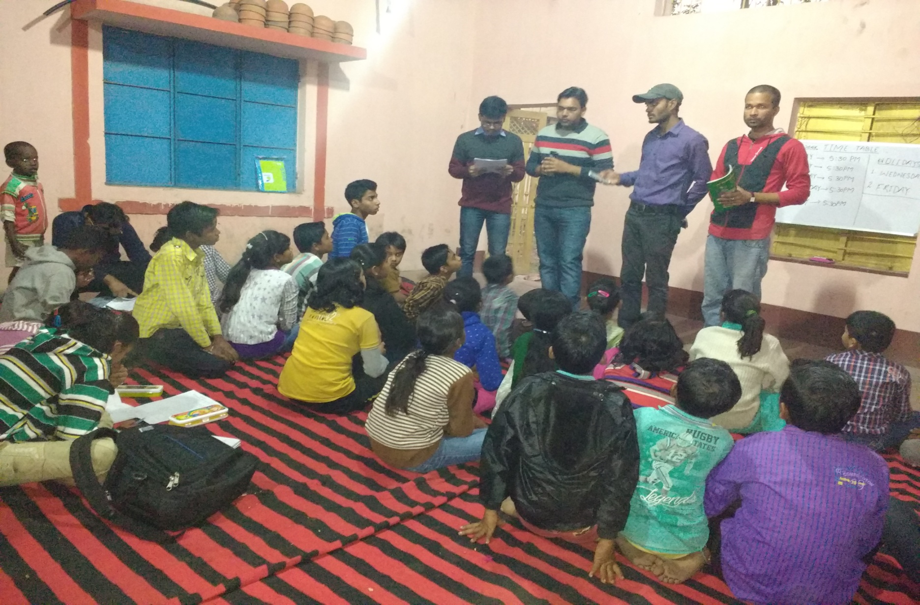
LET US SACRIFICE TODAY SO THAT OUR CHILDREN CAN HAVE A BETTER TOMORROW

Slide 8
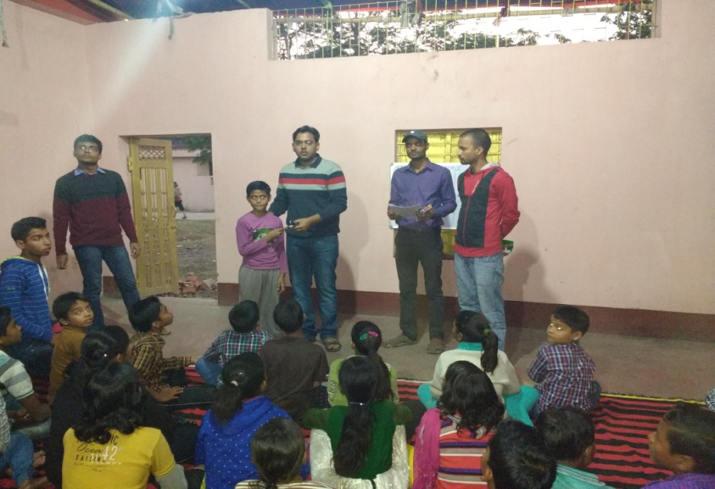
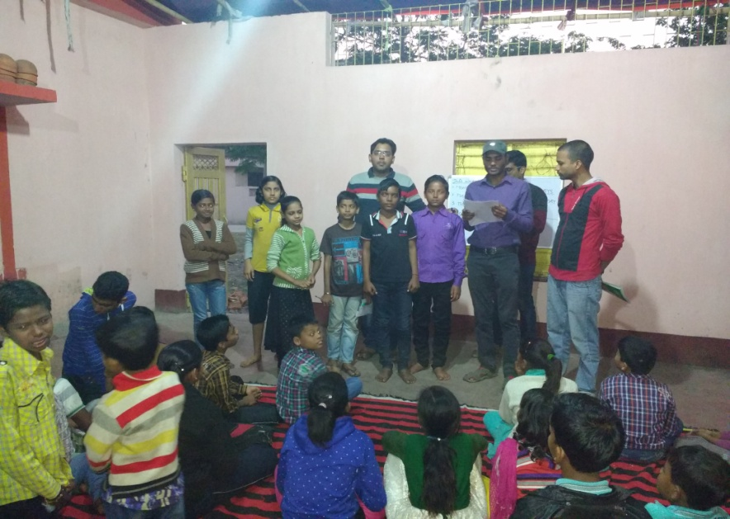
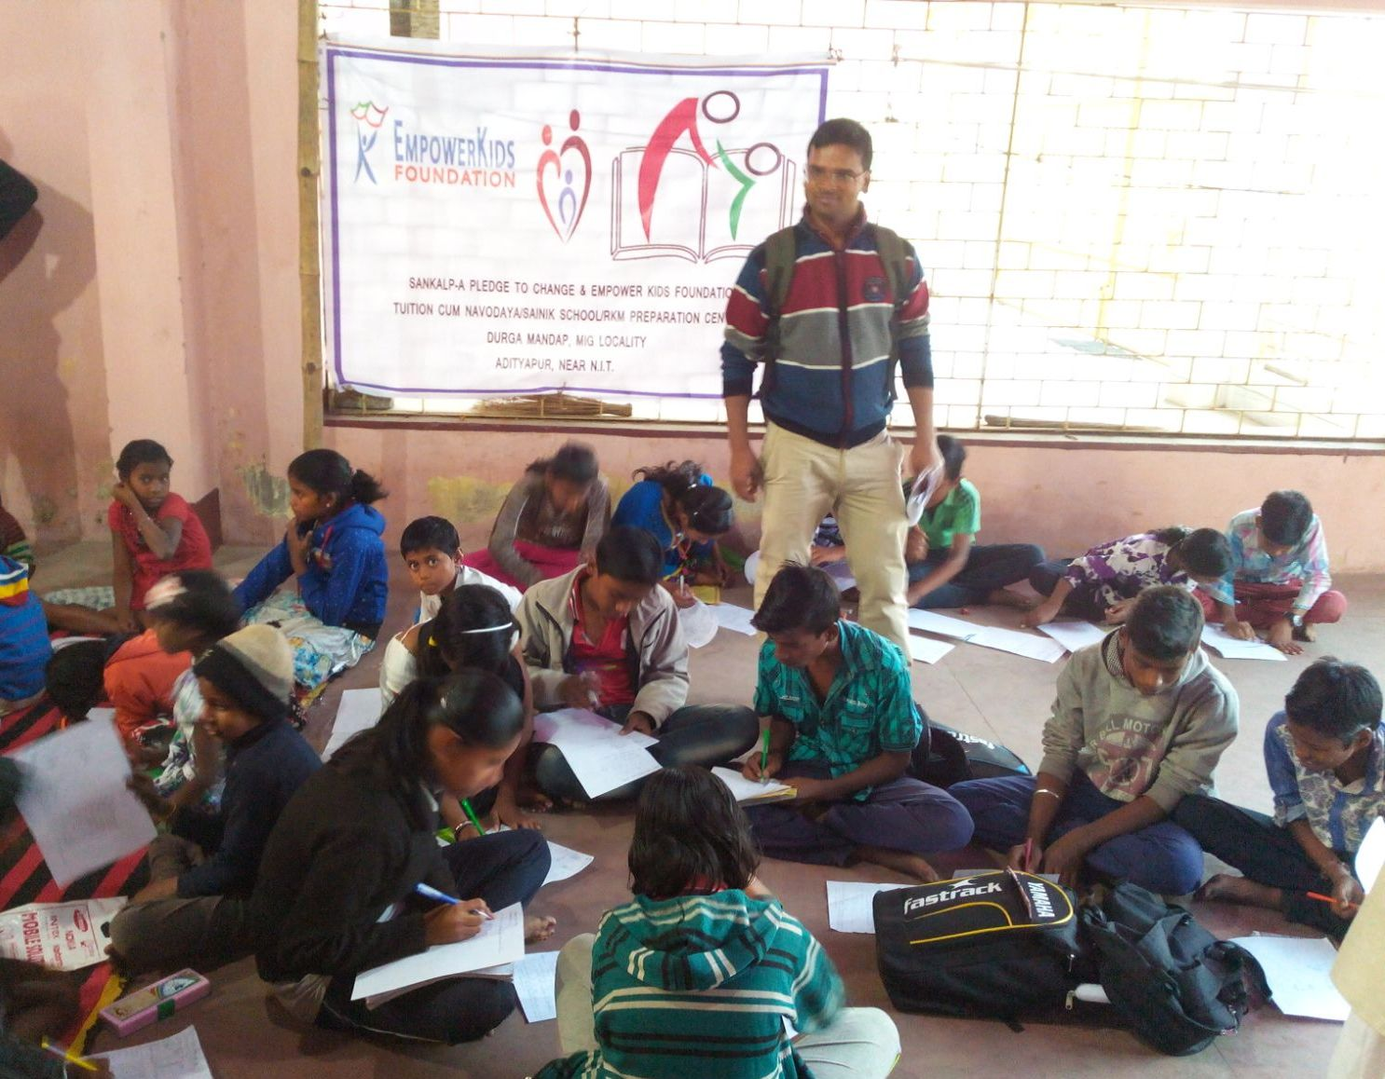

Slide 9
NAVODAYA PREPARATION
CLASSES
IN
FULL SWING

Slide 10
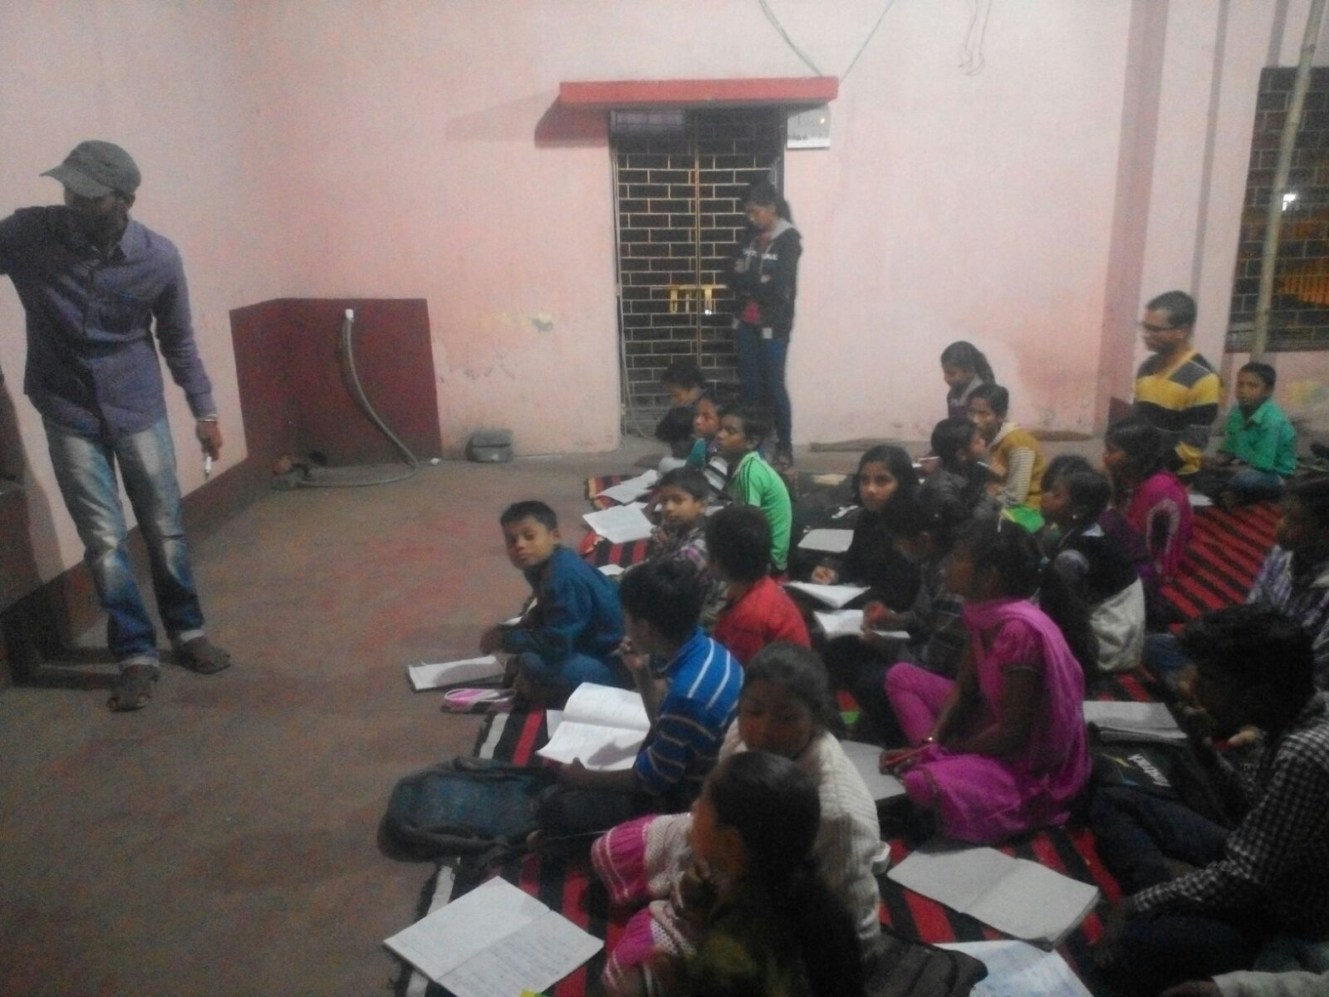

Slide 11
Students’ List
General Tuition Classes
Navodaya Preparation

Slide 12
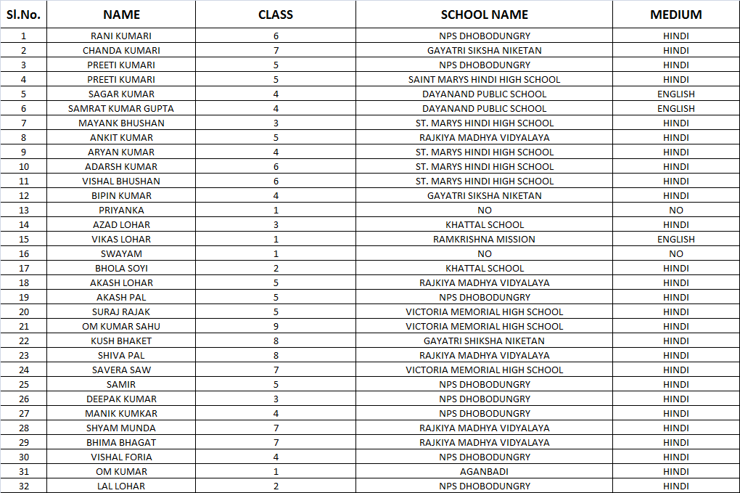
STUDENTS’ LIST-GENERAL TUITIONS (1)

Slide 13
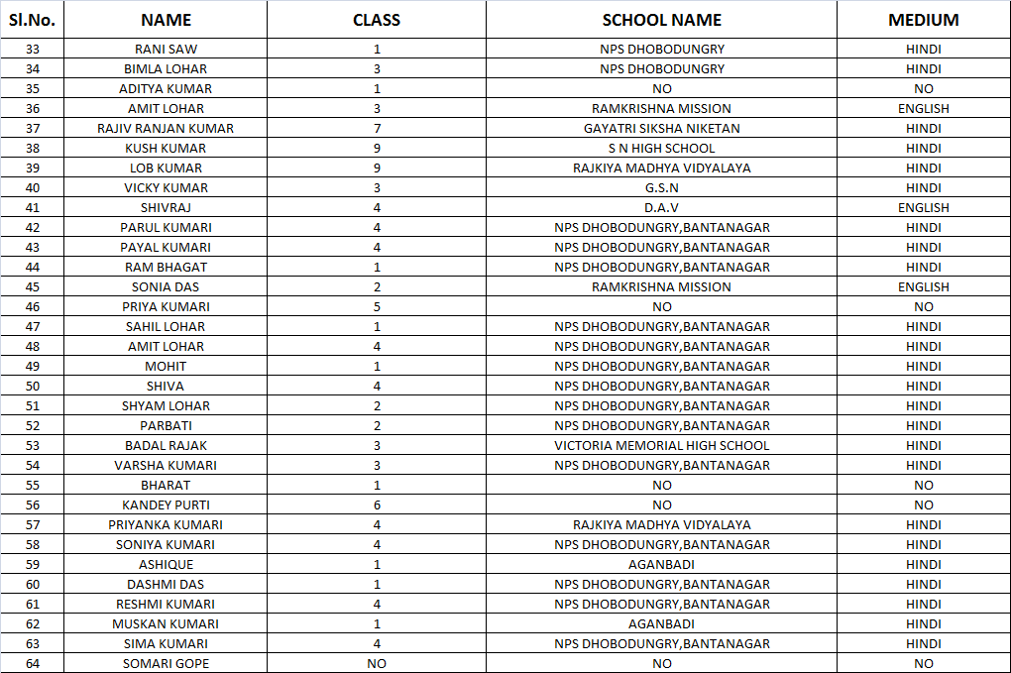
STUDENTS’ LIST-GENERAL TUITIONS (2)

Slide 14
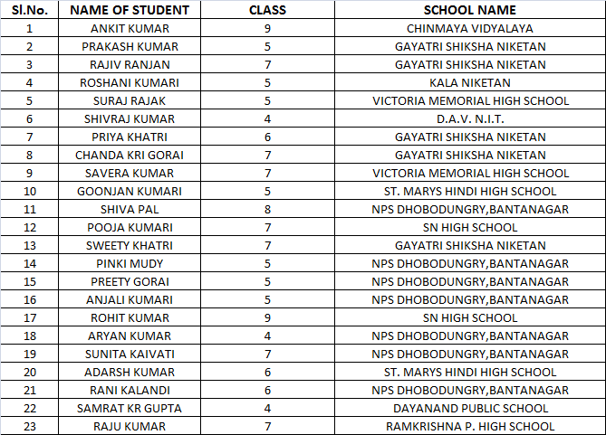
STUDENTS’ LIST-NAVODAYA PREP CLASSES

Slide 15
"Change will not come if we wait for some other person or some other time. We are the ones we've been waiting for. We are the change that we seek.“

Slide 16
COME BE A PART OF THE JOURNEY
You can donate at any our centres by just making a call to Sankalp-A Pledge to Change volunteers.
All our centres are Adityapur based and run 6 days a week
You may donate books from
Class 1-8- Course Text Books (Any Board)
Story Books
Unused stationery
Any other items like bag, toys, uniforms etc.
Relevant Contact Nos. Are
Subodh Kumar Das-9798756336
Mayank Aggarwal -9031975746
Suresh Pareek -7209632032
Vikas Dixit -9472706225

Slide 17
ACCOUNT DETAILS FOR SUPPORT
Sankalp Account Details
You can transfer funds online into our account:-
“SANKALP” A/C No.-31114719936
CIF No: 85757412911
IFSC Code: SBIN0001882
MICR Code: 831002004
Branch code: (1882)
Branch: SBI- RIT JAMSHEDPUR
You may also visit our website and pay through online link available over it.
www.sankalpnitjamshedpur.org

Slide 18
“You have not lived today until you have done something for someone who can never repay you.”
www.sankalpnitjamshedpur.org

